Slide 1

PhD Supervisors Meeting
xx/xx/24

Slide 2

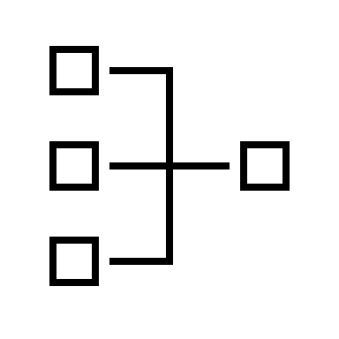

Agenda
REFINED RESEARCH
QUESTIONS
SYSTEM GRAPHIC
ARTICLE SEARCHES

Slide 3
Research Proposal Review: Background
Since the introduction of the IoT, we live in a world where sensors have become common place, and the of devices are projected to nearly double from today’s levels [1]
As these sensors become commonplace, they are generating vast of data from a wide range of systems and devices.
As privacy concerns around this data come increasingly into focus, federated learning is seen as a promising approach which allows data to be gathered on an Edge device, allowing the data to be trained on that device
Federated learning has several challenges which must be addressed, and these challenges will form the basis of this project
[1] L. Sujay Vailshery, "Number of Internet of Things (IoT) connected devices worldwide from 2019 to 2023, with forecasts from 2022 to 2030," Statista, July 2023. [Online]. Available: https://www.statista.com/statistics/1183457/iot-connected-devices-worldwide/. [Accessed 23 11 2].

Slide 4
Research Proposal: Aim and Research Questions
AIM
The overreaching aim of this project will be to advance the understanding and application of federated learning in distributed environments, focusing on model efficiency, overall system security, and communication efficiency.
Focusing on these area, we have some research questions as a starting point.
RQ1: With the ever-increasing use of IoT devices, can FL algorithms or tools be designed to operate specifically on resource Edge devices to minimize computational and communication costs
RQ2: Real-world data will typically have elements of variability that can reduce the accuracy of any model. Can we develop FL algorithms that are adaptable to non IID (Independently and Identically Distributed Data)?
RQ3: Can adaptive communication strategies for FL be developed that dynamically adjust their transmission frequency and allowable bandwidth based on factors such as model complexity, the type of data, and the transmission network condition?
RQ4: Can FL be resilient to unreliable network conditions introducing latency and packet loss while ensuring that model training is reliable, and updates remain efficient and robust
RQ5: How can we design efficient aggregation algorithms for FL that minimize the data exchange between clients and servers while not reducing the model accuracy?
Research
Questions

Slide 5
Literature Review: Databases and Keywords
The following are the main databases which will be used:
IEEE Xplore
Scopus
Science Direct
ACM Digital Library
The following keywords will be used in the searches
Artificial Intelligence
(Decentralised) Machine Learning
Internet of Things/IoT
Data Heterogeneity
Model Aggregation
Communication
EdgeAI/EdgeML/TinyML
Data Privacy
Transfer Learning
Federated Averaging
Manufacturing
Intrusion Detection
Constrained device
Efficient

Slide 6
Abbreviations
Abbreviation | Meaning | Comment
FL | Federated Learning
IID | Independently and Identically Distributed Data | Independent: data is not influenced by data on another device Identically distributed: data on each device has the same overall probability distribution

